Slide 1


CIRCULAR ECONOMY
Case Studies by BASF
Erick Contreras
Managing Director
BASF Vietnam
September 2020
Notes:
BASF is the world's leading chemical company that has been active for over 150 years. We want to be a thought and action leader in Sustainability and to help our customers achieve their sustainability goals through chemical innovation and partnership.
With regards to the Circular Economy, BASF has actively played our part to drive circularity to help Extend the loop (Increase efficiency on processes and effectiveness of products) and Close the loop (Keep materials in the circle e.g. turn waste into new feedstock or increase recyclability).

Slide 2
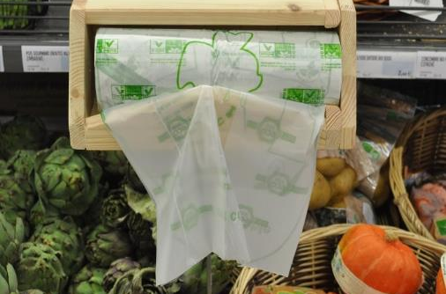
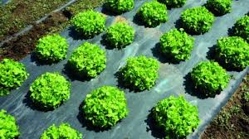
Innovative example for circularity enablement by BASF:
ecovio® biodegradable bags and mulch films
  Certified compostable fruit & vegetable bags/ films
Dual use: fruit/ veggie bag and organic waste bag
Less organic waste in landfill, more compost
Plowable soil-friendly mulch-film for agriculture
Sustainable agricultural solution
Conserves soils and increases crop yields
Saves time and money for after-harvest-care
ecovio® helps close the loop of the food value chain
Notes:
For example, ecovio® is a high-quality and versatile bioplastic from BASF. It is certified biobased and compostable with main applications such as organic waste bags, fruit and vegetable bags, carrier bags with dual-use (first for shopping, then for organic waste) or agricultural films. Furthermore, compostable packaging solutions such as paper-coating, shrink and cling films as well as injection molding and thermoformed products can be produced with ecovio®. ecovio can contribute to reducing food waste, protecting soil quality and returning nutrients to the soil and avoiding the accumulation of plastics in the soil .
Read more here
https://plastics-rubber.basf.com/global/en/performance_polymers/fpgs/fpg_biodegradable_plastics.html
Our major challenges when introducing our compostable bioplastics is the lack of classification standards or guidelines for biodegradable, degradable and compostable products. In addition, that would also be helpful if Vietnam can build a roadmap on how the country will support the bioplastic sector with different measures: preferential tax, infrastructure (industrial compost plants), organic waste classification and collection process. BASF has been active for more than three decades in this area in Europe, North America, Australia, India and many parts of the world and we would be very happy to assist along the way. Refer to the above link

Slide 3

Innovative example for products based on renewable feedstock by BASF: From biomass to dispersion for premium paints
BASF binder enabling interior paints combine environmental responsibility with uncompromising premium quality
Replacing fossil raw materials with renewable feedstock
Less greenhouse gas emissions
Made by BASF: Acronal® MB binder for interior paints
Support customers achieve sustainability requirements
Notes:
Another quick example is Acronal® MB 6453 - BASF Biomass Balance Polymer dispersion as a 100 % substitution of fossil with renewable raw materials for low odor, near zero VOC interior paints, therefore generating less greenhouse gas emissions without compromising quality.

Slide 4
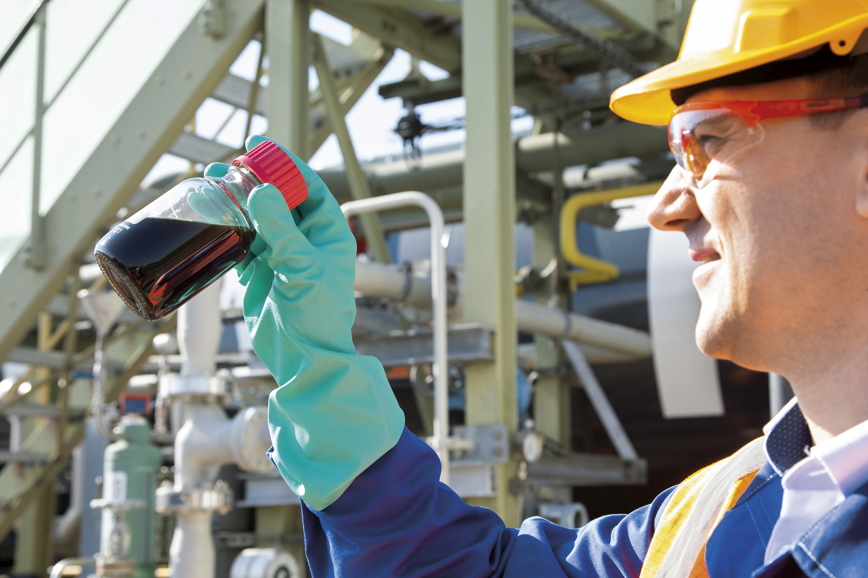

Innovative examples for recycling enablement by BASF: Chemical Recycling is an innovation to close the loop in chemical industry
Recycling – close the loop
Recovery – utilize the energy
Chemical
recycling
Mechanical recycling
Waste to fuel
Incineration
Linear economy
Landfill
Littering
Notes:
Recycling means that plastic waste is neither sent to landfill nor will the material be diverted from the material circle through energy recovery. Waste to fuel may have a value to reduce greenhouse gas emissions in transport or to improve plastics waste management in countries with little infrastructure. However, it is a one-time effect. Future use of the resource is not possible.
The pyrolysis oil will be used along with fossil raw materials to manufacture basic products. The recycled content will then be mathematically allocated to certain sales products via a mass balance approach. The recycling share of chemical products can be certified via a third-party audit. This concept is similar to the approach used for “green” electricity.
ChemCycling represents an exciting business opportunity for us and our customers, as the resulting products are of equal quality to the products derived from fossil feedstock.

